Slide 1

DESIGN THINKING AND INNOVATION
Dr D. Venkata Subbaiah
Professor, Computer Science & Engineering Department
Lakireddy Bali Reddy College of Engineering (A), Mylavaram

Slide 2
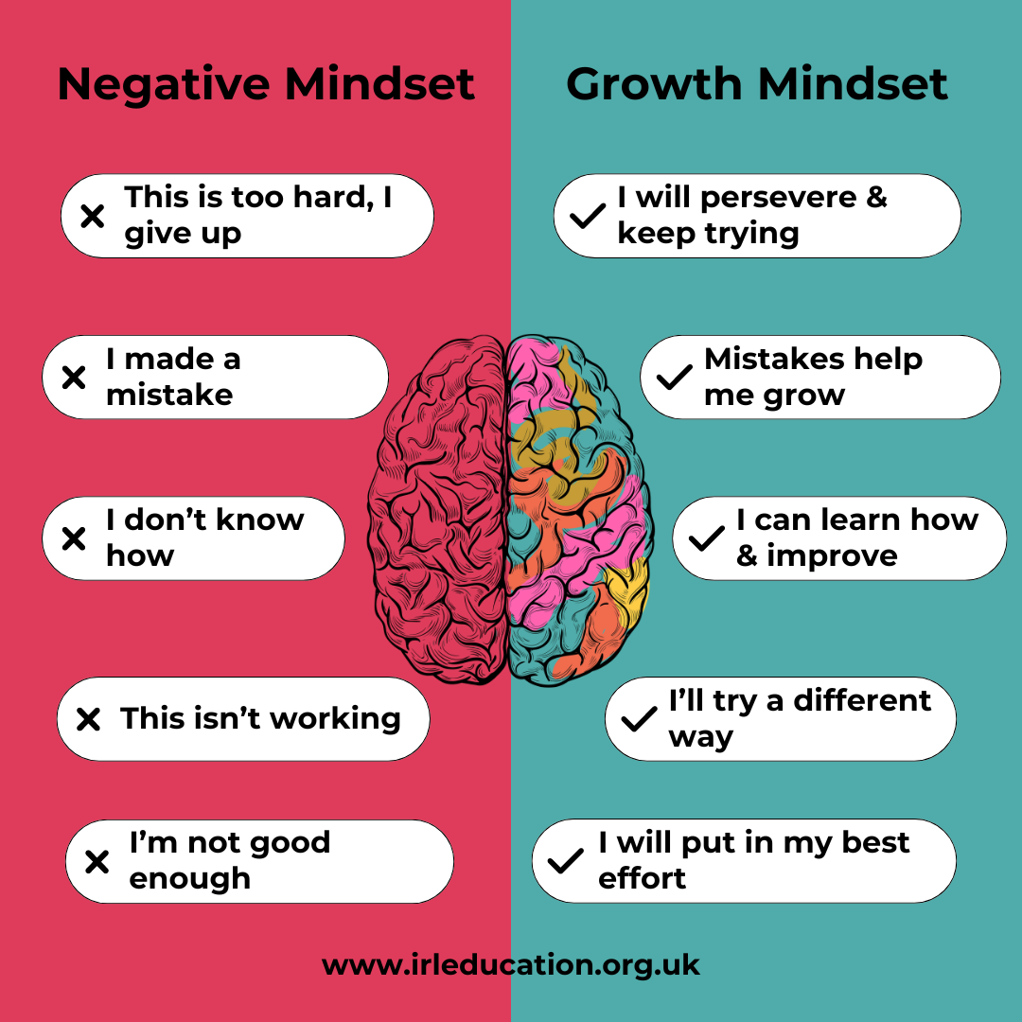
Concept of Design Thinking

Slide 3
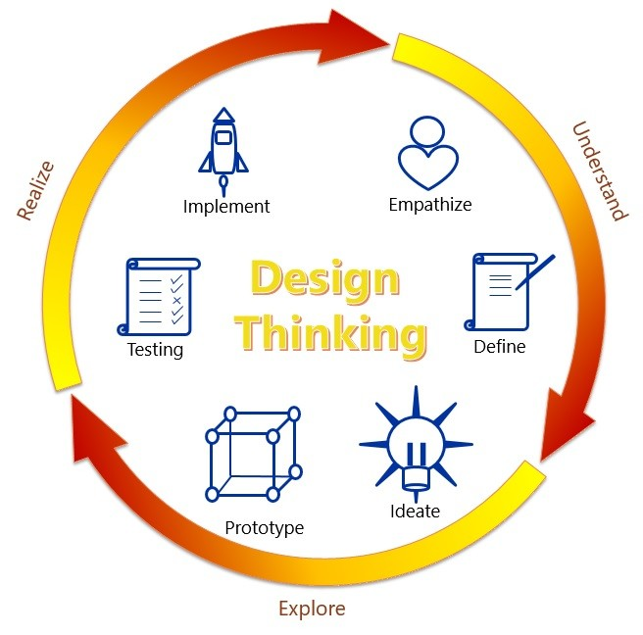
Elements of Design Thinking
6
1
5
2
4
3

Slide 4
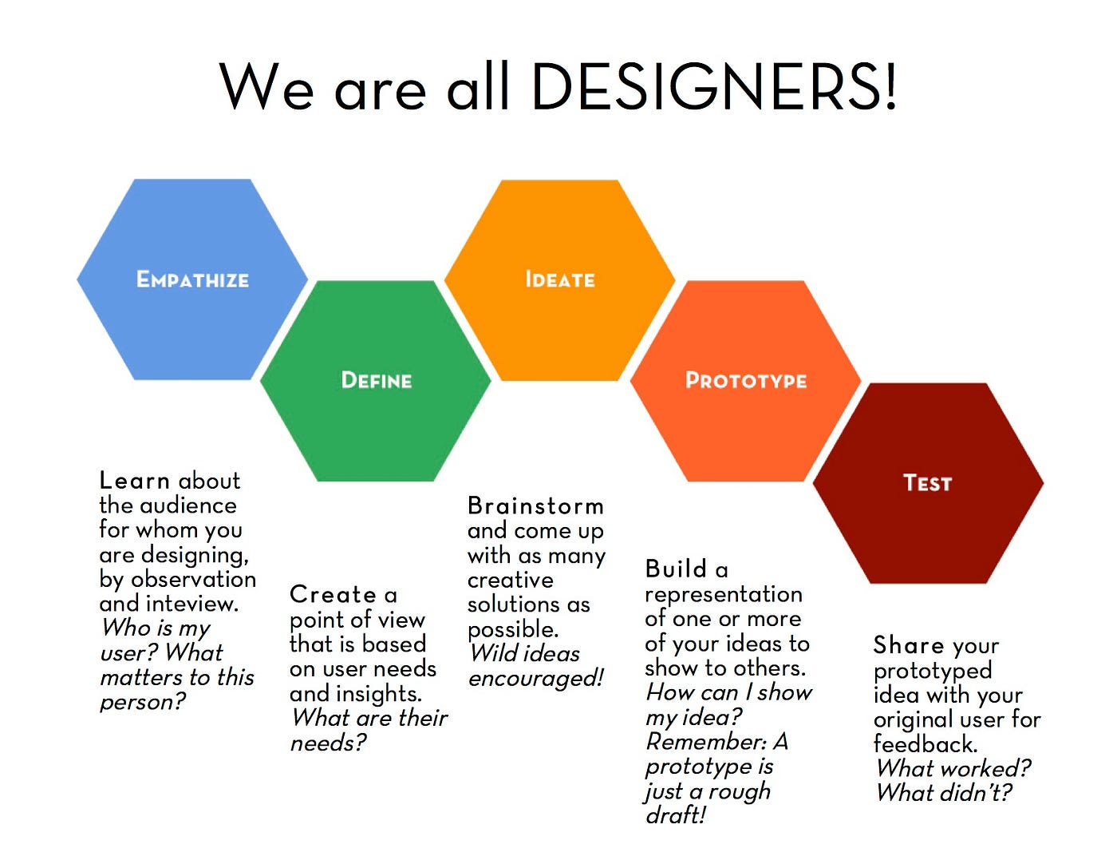
Elements of Design Thinking
INSIGHTS
NEEDS
CONCEPTS
MODELS
REFINE

Slide 5
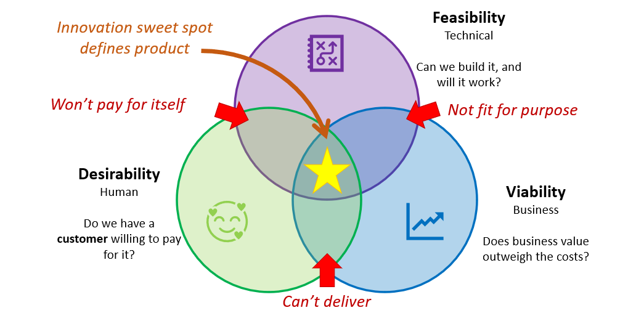
Elements of Design Thinking
Innovation/Outcome

Slide 6
Elements of Design Thinking: Define
Objectives
to transform Insights to Needs
to pinpoint core problems and potential opportunities for creating potential solutions
Work plan
Generally done in a group and/or small teams
It helps everyone have the same information, allows for multiple interpretations and therefore deeper insights.
Sometimes the problem identified is not the one the group thought they’d set out to tackle.
It may be different, broader, or more nuanced than it was originally assumed to be.
These insights are summarized in documents such as empathy maps, personas and user journeys.

Slide 7
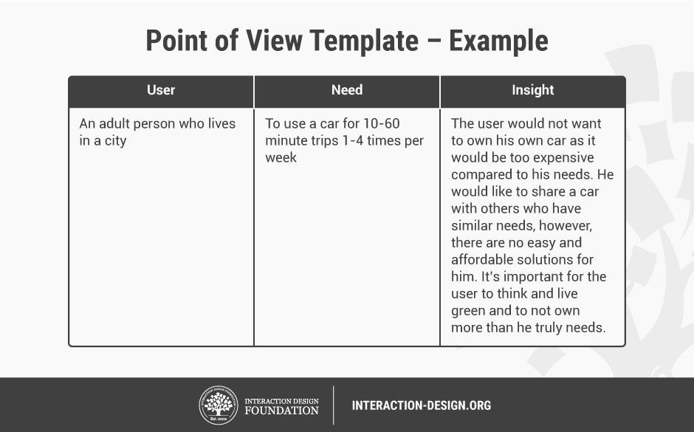
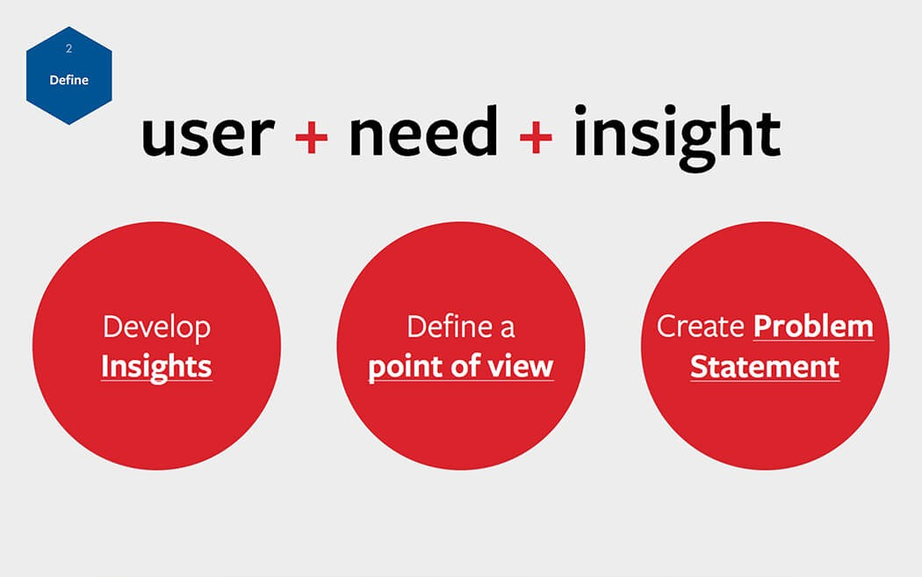
Elements of Design Thinking: Define

Slide 8
Elements of Design Thinking: Define
Steps to be followed
Clarity from Wants to Needs
Scope of problem
User/Customer Journey Maps
Point of View Statements
Choosing and developing a persona
Point of View Statements ( Need of User)
Role based (User/Manager/Officer etc)
Situation based (Location Based)
Point of View Questions (For the Designer)

Slide 9
Types of Point of View Statements
ROLE-BASED: Certain types of people want to get jobs done to meet psychological needs.
SITUATION-BASED: All people face Certain Situations where they want to meet psychological needs
ROLE-BASED POINT OF VIEW STATEMENT
I’m a STUDENT (that’s my role), and I want to get good marks (job to be done) so I can have a good relationship with my parents (benefit desired: affiliation)
I’m a STUDENT (that’s my role), and I want to get good marks (job to be done) so I can have a good relationship with my parents (benefit desired: affiliation)
SITUATION-BASED POINT OF VIEW STATEMENT
When I WRITE AN EXAM (that’s the situation), I feel nervous (immediate need or problem) because I might get an embarrassing score (benefit desired: esteem).

Slide 10
Elements of Design Thinking: Define
POV Statement (Need of User):
I need to enter bus stand and reach my platform without any difficulty
POV Question (for the Designer):
What should I provide to make the passenger easily reach his Platform in bus stand without any difficulty?

Slide 11
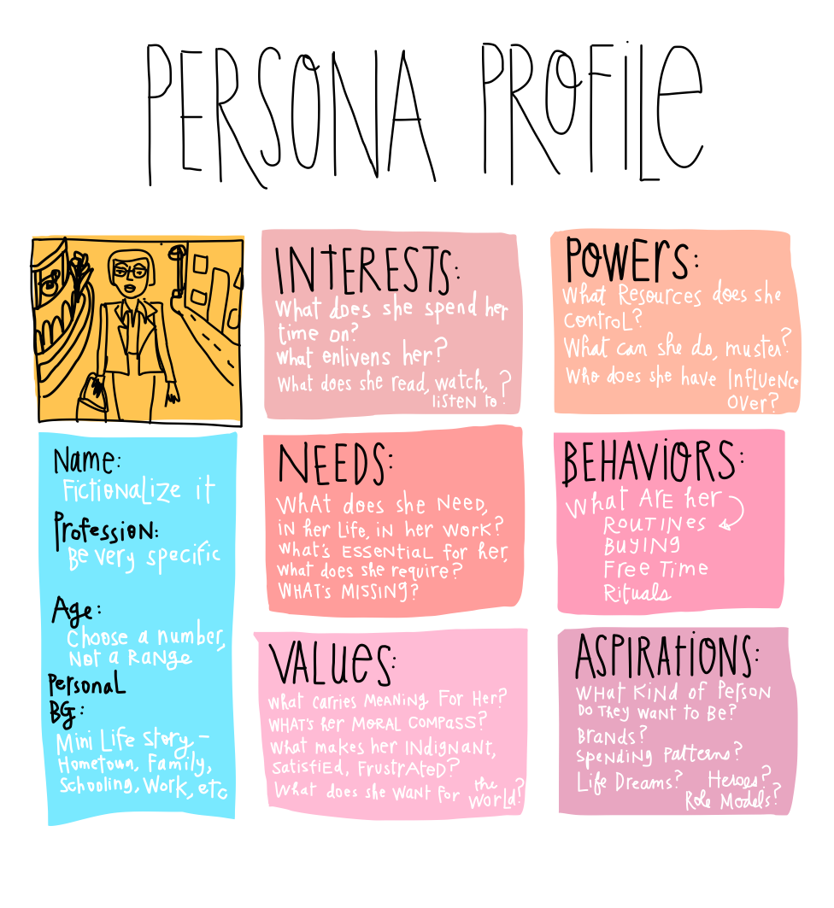
Elements of Design Thinking: Define
PERSONA
A brief CV of a person or Customer or User with short information.
It highlights his particulars, Interests, Aspirations, Challenges, Needs, Values and Behaviors followed by a summary.

Slide 12
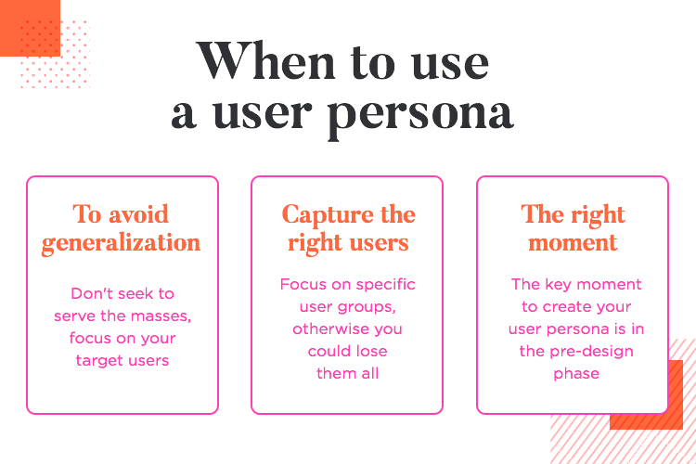
Elements of Design Thinking: Define

Slide 13
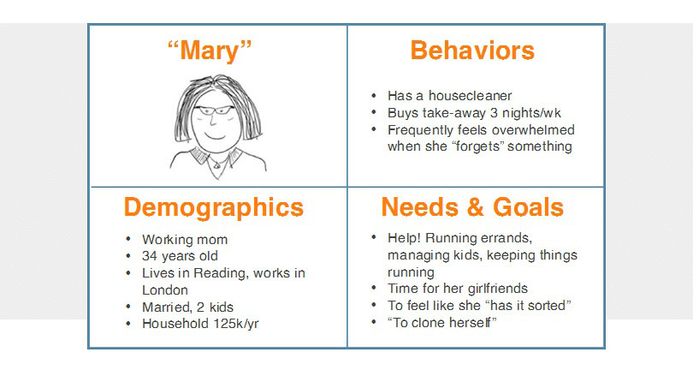
Elements of Design Thinking: Define

Slide 14
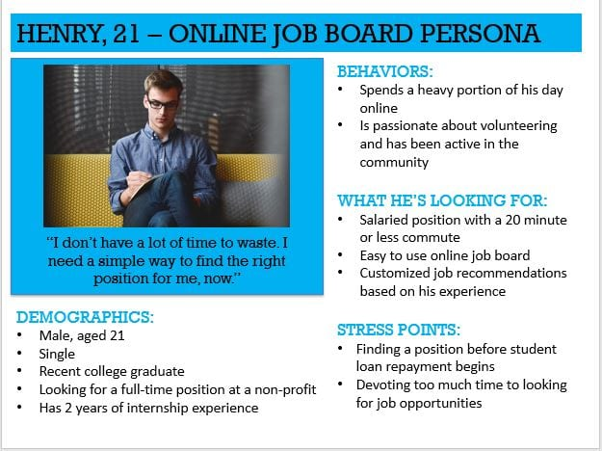
Elements of Design Thinking: Define

Slide 15
Elements of Design Thinking: Define
Customer Journey Maps: Online Purchase of a Product
Open the App based on requirement
Browse the products
Select the product
Check the specifications
Check the rates and Offers
Take Feedback from Neighbors or Users
Compare the Prices
Repeat the Process: Product selection, Specs, Price Discounts
Open another App
Check with Reviews of the Product
Check with Payment and Delivery Option
Check with Discounts on a Credit Card payment
Take a decision, Order and Receive the product

Slide 16
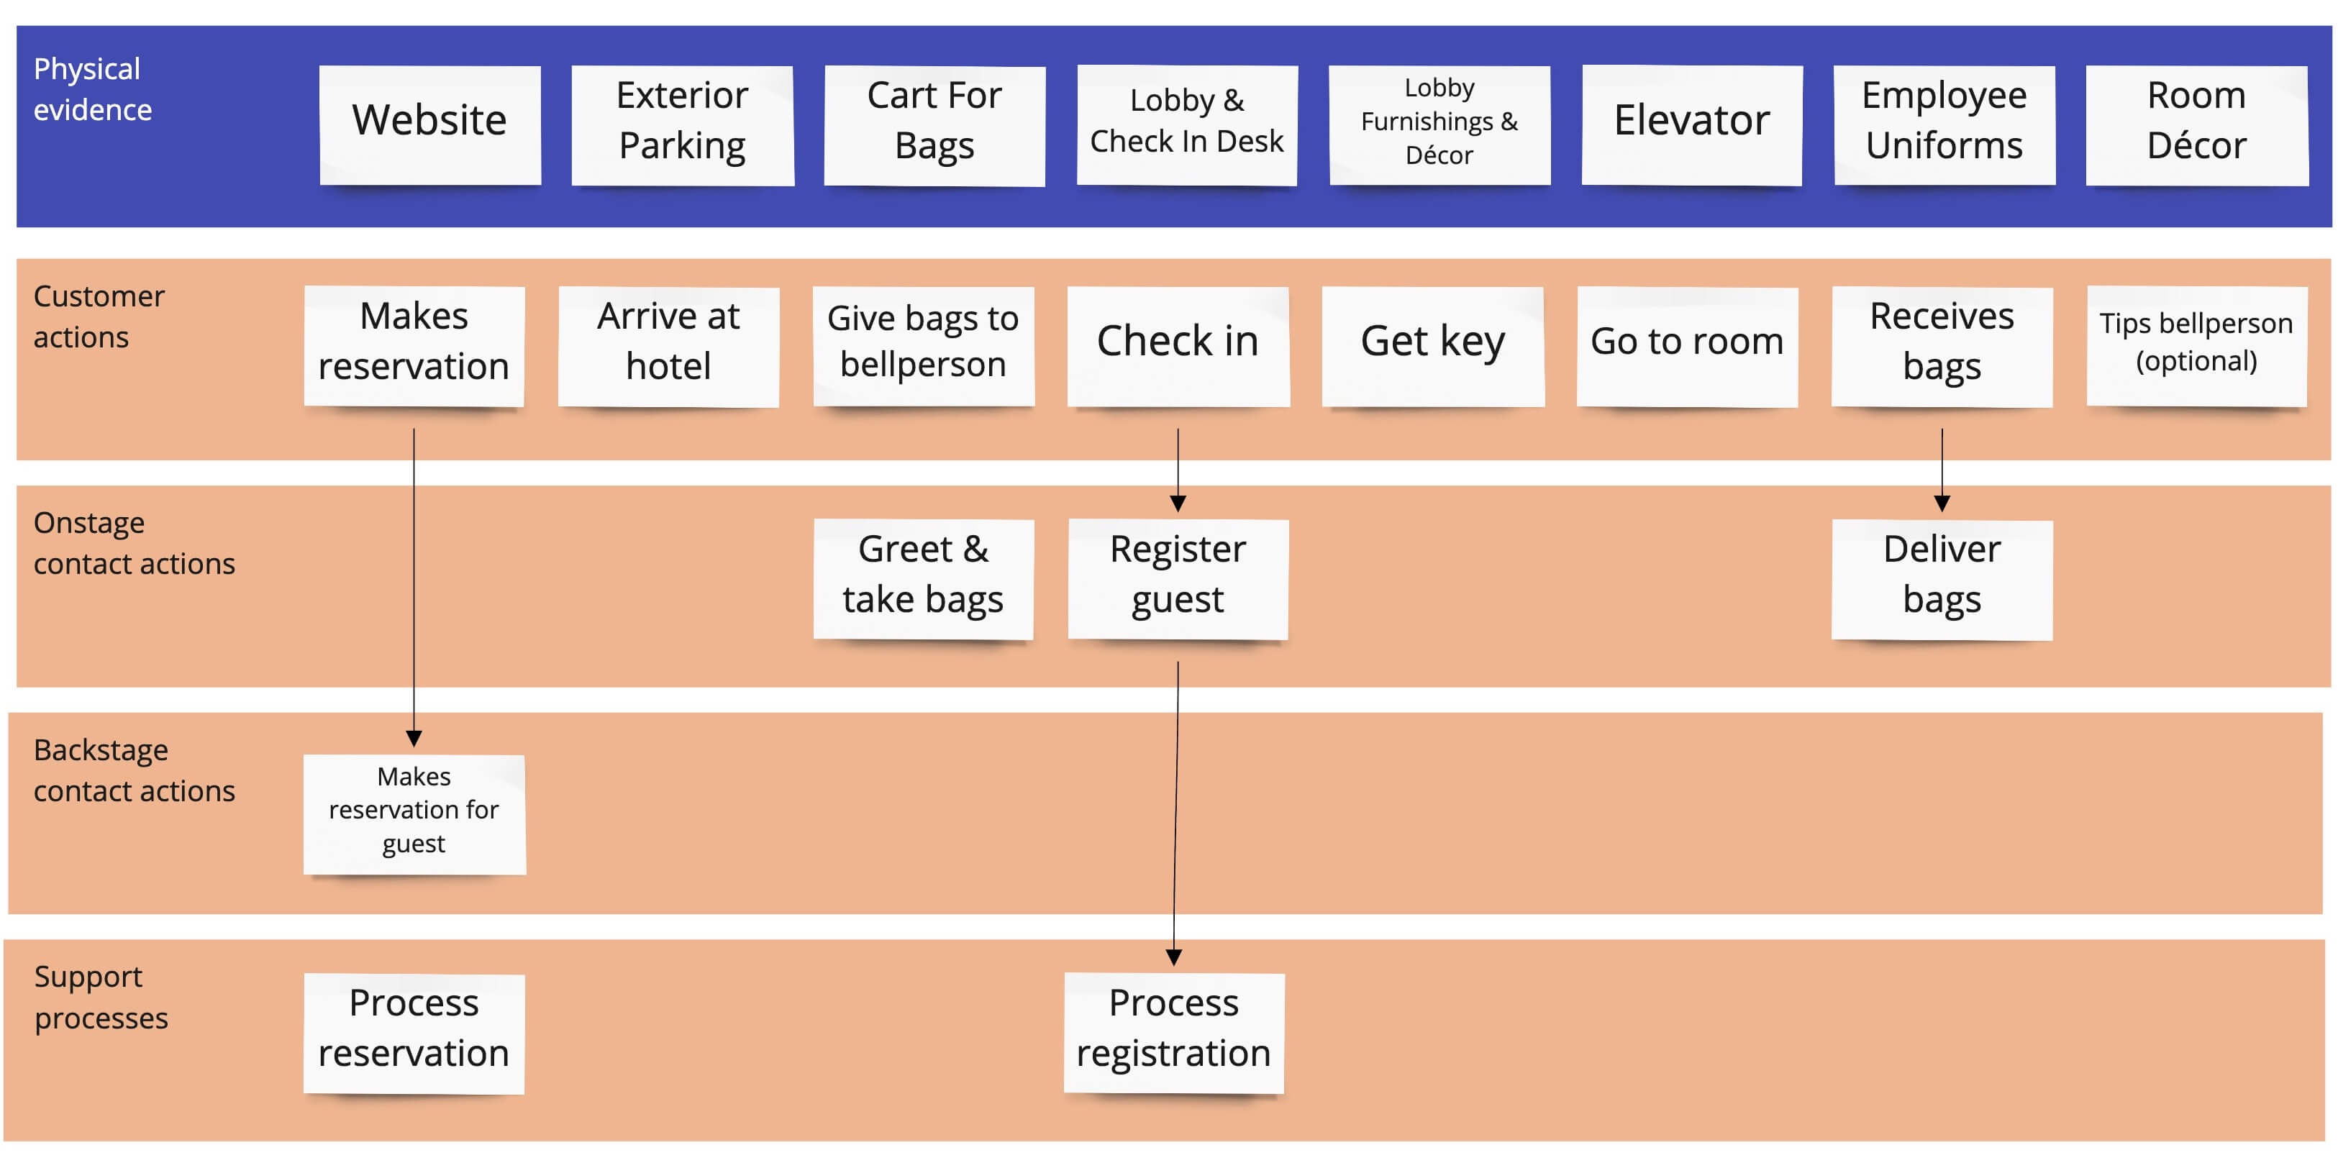
Elements of Design Thinking: Define
Customer Journey Maps: Hotel Service System

Slide 17
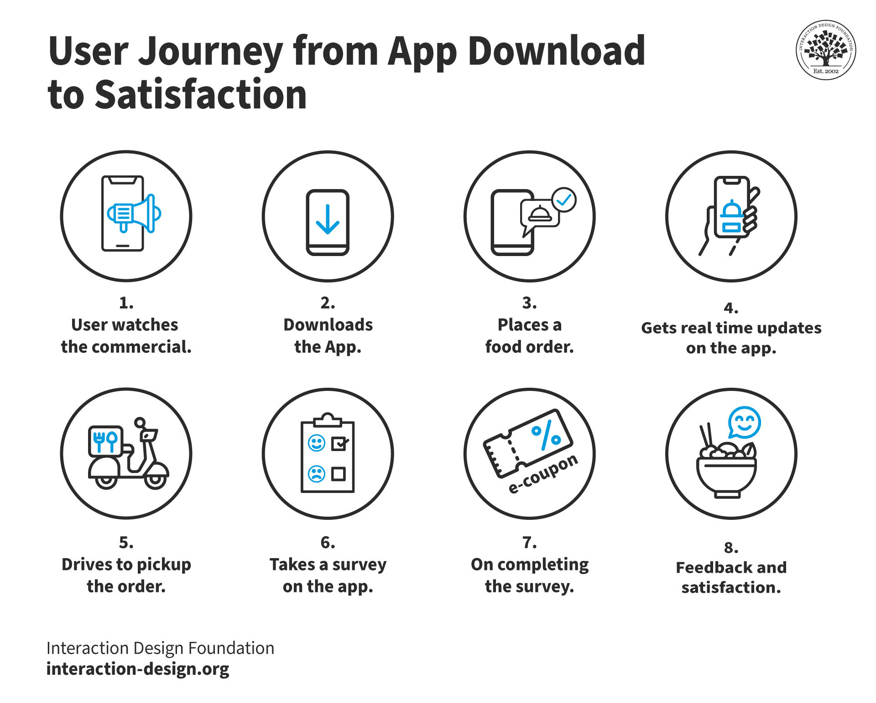
Elements of Design Thinking: Define
STORY BOARD

Slide 18
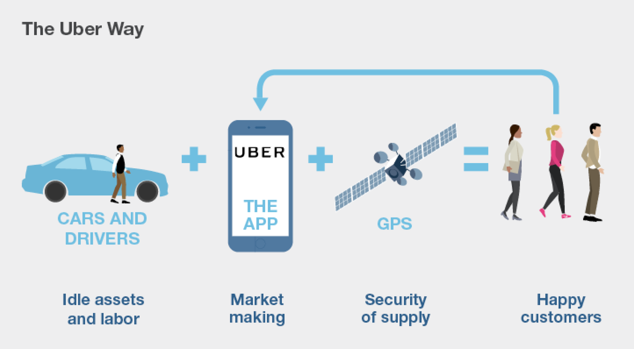
Elements of Design Thinking: Define
Hire the cab online
CASE STUDIES

Slide 19
Elements of Design Thinking: Define
Develop POV or Persona or story board for any of the problems. Think for a specific perspective
Coffee shop Problem - selection of specific model and snacks
Entering into a bus stand and identify your bus and platform
Exploring the utilities at a Railway station or Bus station
Following or cooking a Recipe at kitchen
Classifying or selection of right decoration for a party
Planning your daily schedule based on priorities
Finding a Library Book in the Library
Driving to or from Somewhere
Deciding how to plan a trip
Develop a Persona for a specific Customer and develop the brief story for him
Activity
https://www.learning.com/blog/7-examples-of-algorithms-in-everyday-life-for-students/

Slide 20


